Slide 1
Beginner Level for Android Development using Kotlin
Instructor: Ferry Yuwono

Slide 2
Module 2:
Develop Your First Android Application

Slide 3
Course Outline
Module 2: Develop Your First Android Application
2.1 Android Project Structure
2.2 Layouts and TextView
2.3 EditText and Button
2.4 ImageView and ImageButton
2.5 View Binding
2.6 Persistent data
2.7 Activity and Manifest
2.8 RecyclerView and Adapter
2.9 Final Assignment

Slide 4
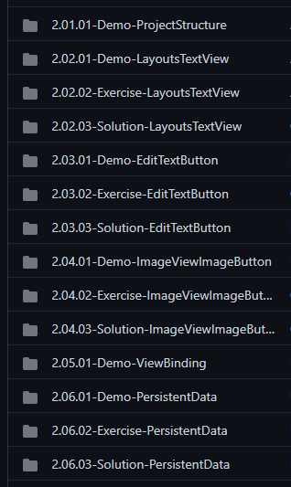
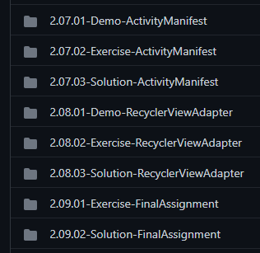
Course Outline
Repository
https://github.com/ferryyuwono/android-beginner
Demo Code
Exercise Code
Solution Code

Slide 5
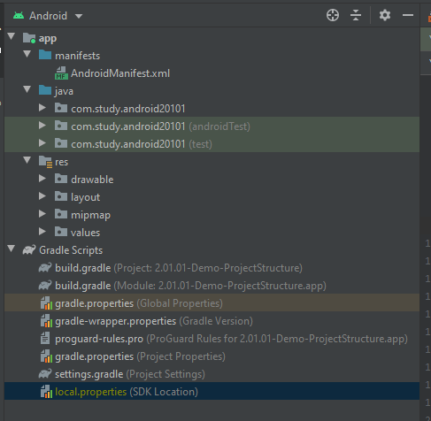
2.1 Android Project Structure
https://github.com/ferryyuwono/android-beginner/tree/main/2.01.01-Demo-ProjectStructure
Manifest
Java
Resources
Gradle Scripts

Slide 6
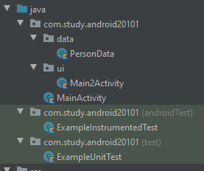
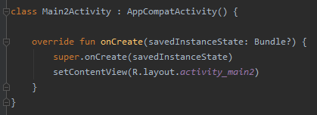
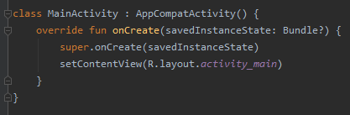
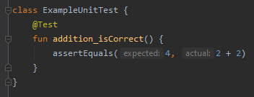
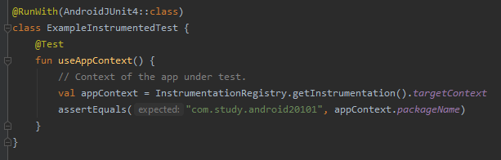
Java

Slide 7
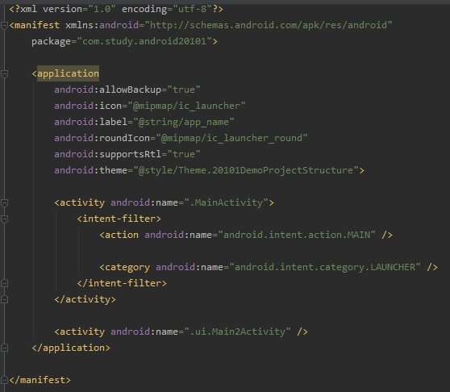

AndroidManifest
Application
Activity Main
Launcher
Activity Main 2

Slide 8
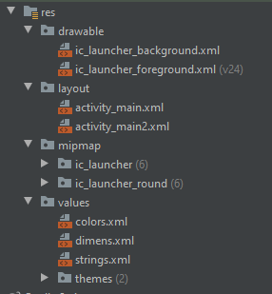
Resources
Drawable (image, vector, shape, selector, etc)
Layout (activity, layout, etc)
Mipmap (launcher icon)
Values (colors, dimensions, strings, themes, styles, etc)

Slide 9

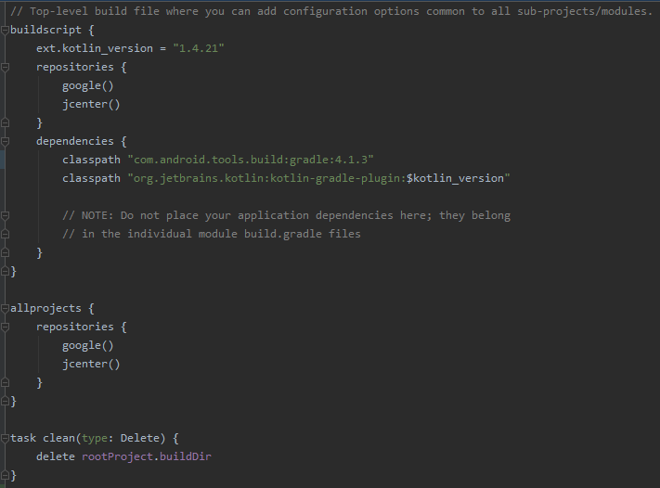
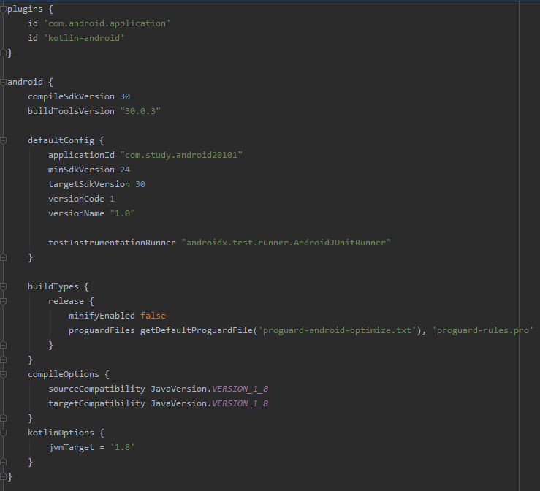
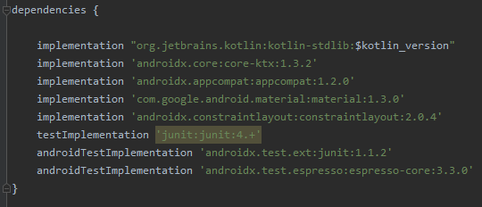
Gradle Scripts
Project settings
(kotlin version, depencesies, repository, etc)
Module settings (app)
(plugins, app version, sdk, dependencies, etc)

Slide 10
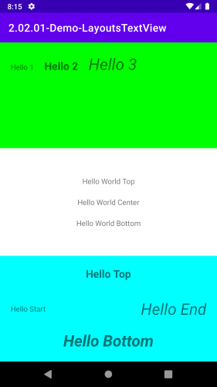
2.2.1 [Demo] Layouts and TextView
https://github.com/ferryyuwono/android-beginner/tree/main/2.02.01-Demo-LayoutsTextView
File: activity_main.xml
ConstraintLayout
LinearLayout
RelativeLayout
TextView

Slide 11
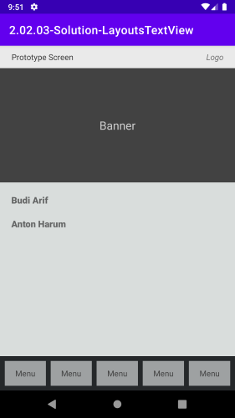
2.2.2 [Exercise] Layouts and TextView
https://github.com/ferryyuwono/android-beginner/tree/main/2.02.02-Exercise-LayoutsTextView
File: activity_main.xml, strings.xml, colors.xml
Expected Result
Extract resource to strings
Extract resource to colors
Style Layout and Textview
LinearLayout weight

Slide 12
2.2.3 [Solution] Layouts and TextView
https://github.com/ferryyuwono/android-beginner/tree/main/2.02.03-Solution-LayoutsTextView
File: activity_main.xml, strings.xml, colors.xml
Expected Result
Extract resource to strings
Extract resource to colors
Style Layout and Textview
LinearLayout weight

Slide 13
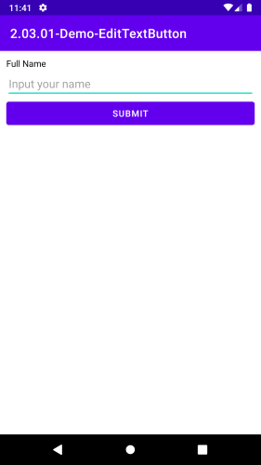
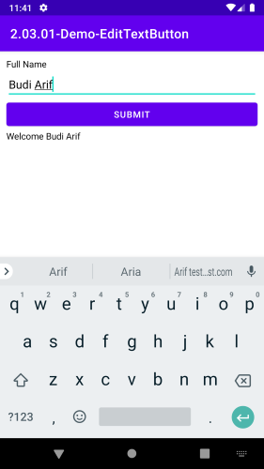
2.3.1 [Demo] EditText and Button
https://github.com/ferryyuwono/android-beginner/tree/main/2.03.01-Demo-EditTextButton
File: activity_main.xml, MainActivity.kt
EditText
Button
OnClick Event Handler
Tools Attribute

Slide 14
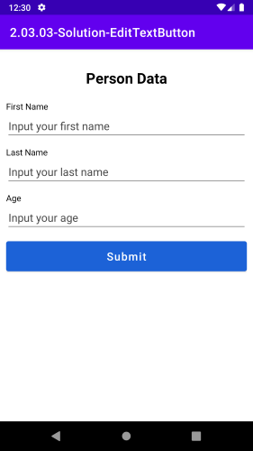
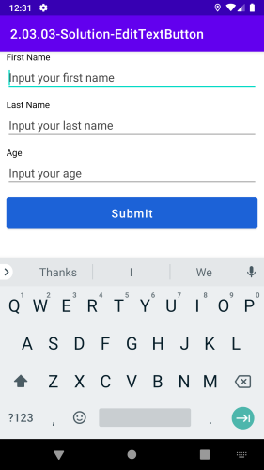
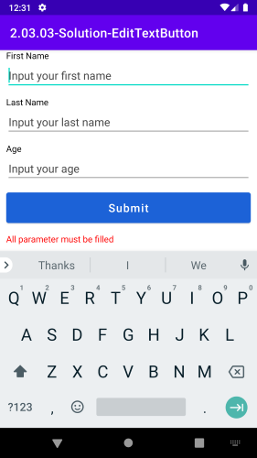
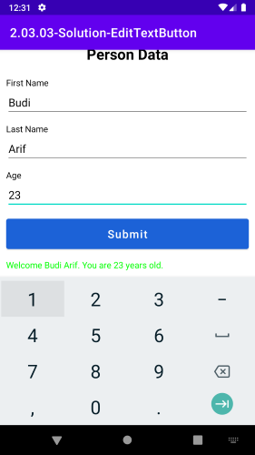
2.3.2 [Exercise] EditText and Button
https://github.com/ferryyuwono/android-beginner/tree/main/2.03.02-Exercise-EditTextButton
File: activity_main.xml, MainActivity.kt
Expected Result
Scrollable
Validation
Valid message
ScrollView
Style EditText
Style Button
Validation

Slide 15
2.3.3 [Solution] EditText and Button
https://github.com/ferryyuwono/android-beginner/tree/main/2.03.03-Solution-EditTextButton
File: activity_main.xml, MainActivity.kt
Expected Result
Scrollable
Validation
Valid message
ScrollView
Style EditText
Style Button
Validation

Slide 16
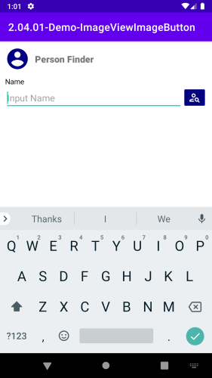
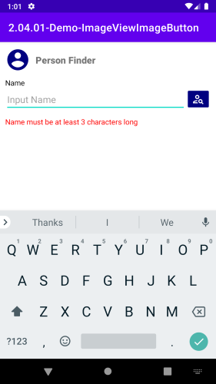
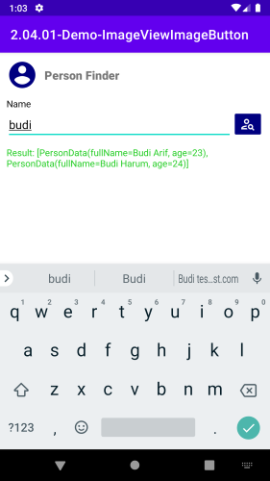
2.4.1 [Demo] Image and ImageButton
https://github.com/ferryyuwono/android-beginner/tree/main/2.04.01-Demo-ImageViewImageButton
File: activity_main.xml, MainActivity.kt, selector_button_search.xml
Drawable
ImageView
ImageButton
Selector Button

Slide 17
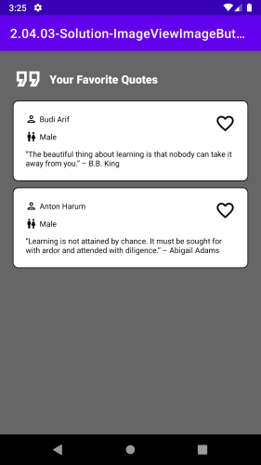
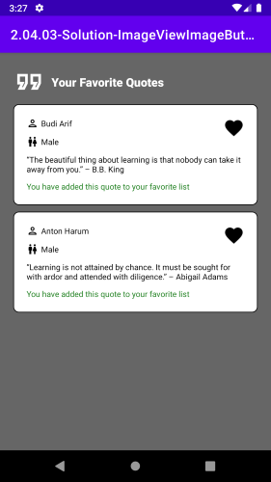
2.4.2 [Exercise] ImageView and ImageButton
https://github.com/ferryyuwono/android-beginner/tree/main/2.04.02-Exercise-ImageViewImageButton
File: activity_main.xml, MainActivity.kt, shape_person_background.xml, selector_checkbox_favorite.xml
Expected Result
Shape
CheckBox
Selector CheckBox
Visibility

Slide 18
2.4.3 [Solution] ImageView and ImageButton
https://github.com/ferryyuwono/android-beginner/tree/main/2.04.03-Solution-ImageViewImageButton
File: activity_main.xml, MainActivity.kt, shape_person_background.xml, selector_checkbox_favorite.xml
Expected Result
Shape
CheckBox
Selector CheckBox
Visibility

Slide 19
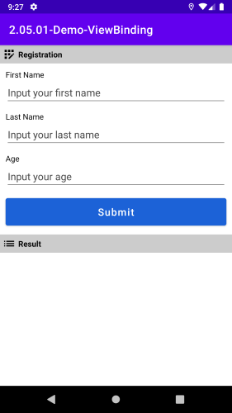
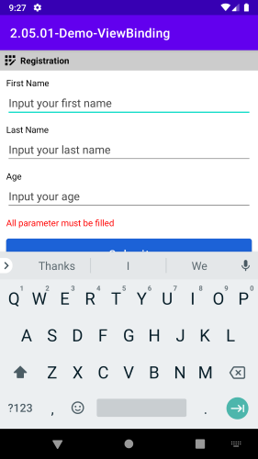
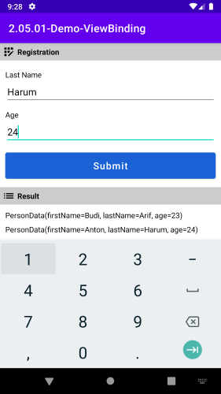
2.5.1 [Demo] View Binding
https://github.com/ferryyuwono/android-beginner/tree/main/2.05.01-Demo-ViewBinding
File: build.gradle, activity_main.xml, MainActivity.kt

Slide 20


2.5.1 [Demo] View Binding

Slide 21
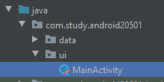
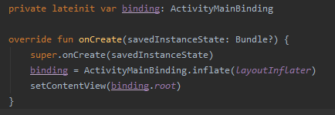
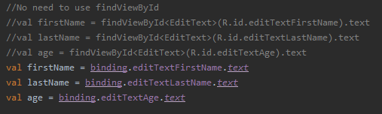
2.5.1 [Demo] View Binding

Slide 22
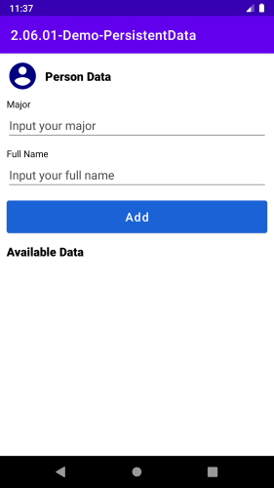
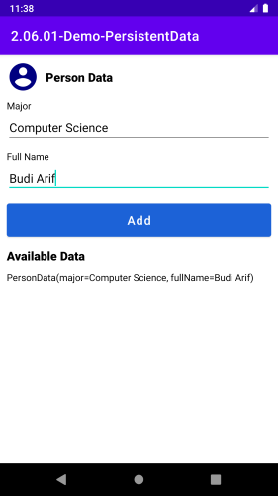

2.6.1 [Demo] Persistent Data
https://github.com/ferryyuwono/android-beginner/tree/main/2.06.01-Demo-PersistentData
File: activity_main.xml, MainActivity.kt
First Run
Save Major
Second Run
Shared Preferences
Get Persistent Data
Save Persistent Data

Slide 23
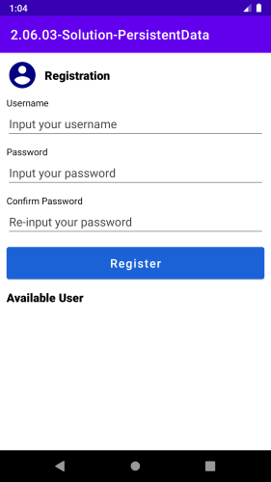
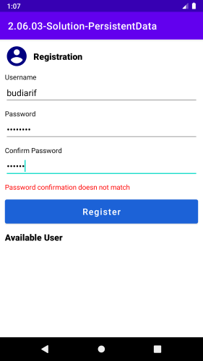
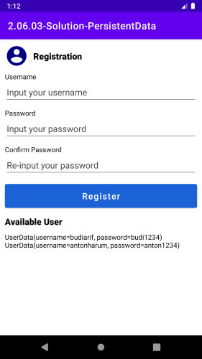
2.6.2 [Exercise] Persistent Data
https://github.com/ferryyuwono/android-beginner/tree/main/2.06.02-Exercise-PersistentData
File: build.gradle, activity_main.xml, MainActivity.kt
First Run
Validation
Add data & Second Run
EditText Password
Module Dependencies
Gson

Slide 24
2.6.3 [Solution] Persistent Data
https://github.com/ferryyuwono/android-beginner/tree/main/2.06.03-Solution-PersistentData
File: build.gradle, activity_main.xml, MainActivity.kt
First Run
Validation
Add data & Second Run
EditText Password
Module Dependencies
Gson

Slide 25
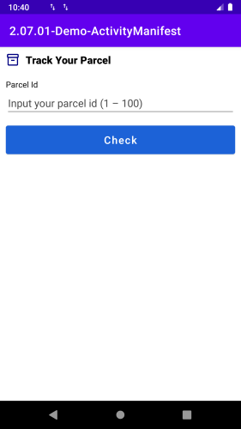
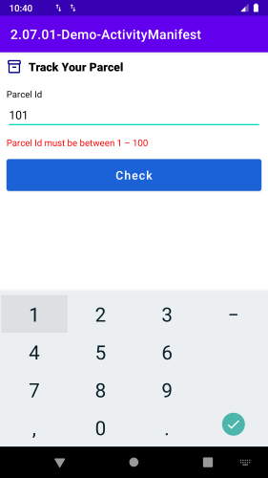
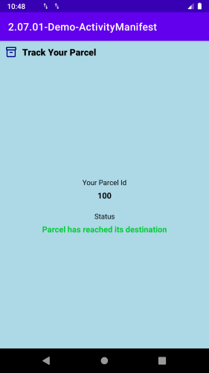
2.7.1 [Demo] Activity and Manifest
https://github.com/ferryyuwono/android-beginner/tree/main/2.07.01-Demo-ActivityManifest
File: activity_main.xml, MainActivity.kt, activity_status.xml, StatusActivity.kt, AndroidManifest.xml
Multiple activity
Activity in Manifest
Intent extra

Slide 26
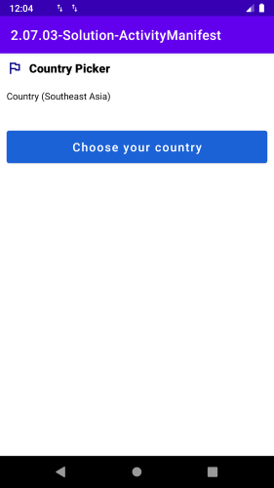
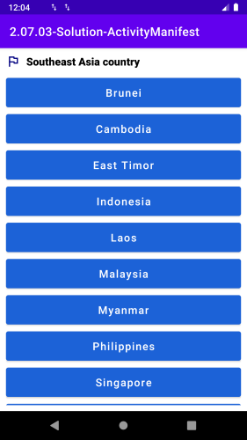
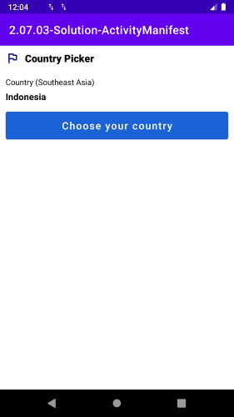
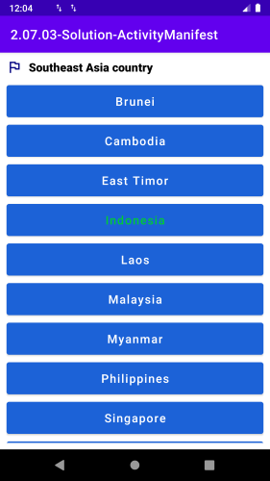
2.7.2 [Exercise] Activity and Manifest
https://github.com/ferryyuwono/android-beginner/tree/main/2.07.02-Exercise-ActivityManifest
File: activity_main.xml, MainActivity.kt, activity_country.xml, CountryActivity.kt, AndroidManifest.xml
startActivityForResult
onActivityResult
String intent extra

Slide 27
2.7.3 [Solution] Activity and Manifest
https://github.com/ferryyuwono/android-beginner/tree/main/2.07.03-Solution-ActivityManifest
File: activity_main.xml, MainActivity.kt, activity_country.xml, CountryActivity.kt, AndroidManifest.xml
startActivityForResult
onActivityResult
String intent extra

Slide 28
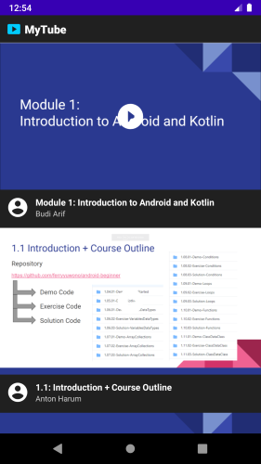
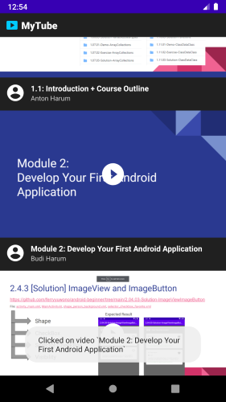
2.8.1 [Demo] RecyclerView and Adapter
https://github.com/ferryyuwono/android-beginner/tree/main/2.08.01-Demo-RecyclerViewAdapter
File: build.gradle, themes.xml, activity_main.xml, MainActivity.kt, item_video.xml, VideoAdapter.kt, VideoViewHolder.kt
NoActionBar
RecyclerView
Tools Sample
Adapter

Slide 29
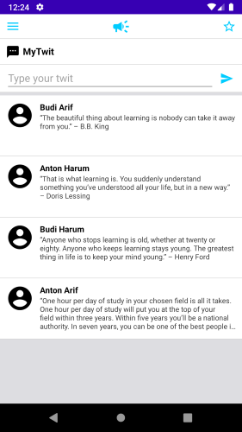
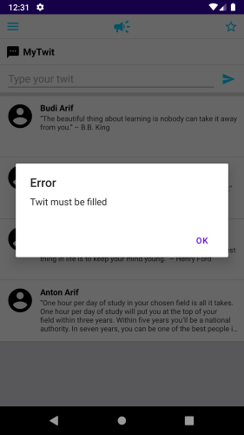
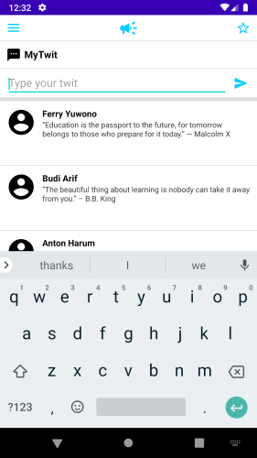
2.8.2 [Exercise] RecyclerView and Adapter
https://github.com/ferryyuwono/android-beginner/tree/main/2.08.02-Exercise-RecyclerViewAdapter
File: build.gradle, activity_main.xml, MainActivity.kt, item_twit.xml, TwitAdapter.kt, TwitViewHolder.kt
Add Data Adapter
Alert Dialog

Slide 30
2.8.3 [Solution] RecyclerView and Adapter
https://github.com/ferryyuwono/android-beginner/tree/main/2.08.03-Solution-RecyclerViewAdapter
File: build.gradle, activity_main.xml, MainActivity.kt, item_twit.xml, TwitAdapter.kt, TwitViewHolder.kt
Add Data Adapter
Alert Dialog

Slide 31
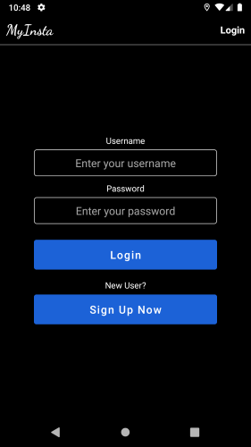


2.8.1 [Exercise] Final Assignment
https://github.com/ferryyuwono/android-beginner/tree/main/2.09.01-Exercise-FinalAssignment

Slide 32



2.8.1 [Exercise] Final Assignment

Slide 33



2.8.2 [Solution] Final Assignment
https://github.com/ferryyuwono/android-beginner/tree/main/2.09.02-Solution-FinalAssignment

Slide 34
End of Module 2:
Good Job and Keep Learning!

